Slide 1


Slide 2
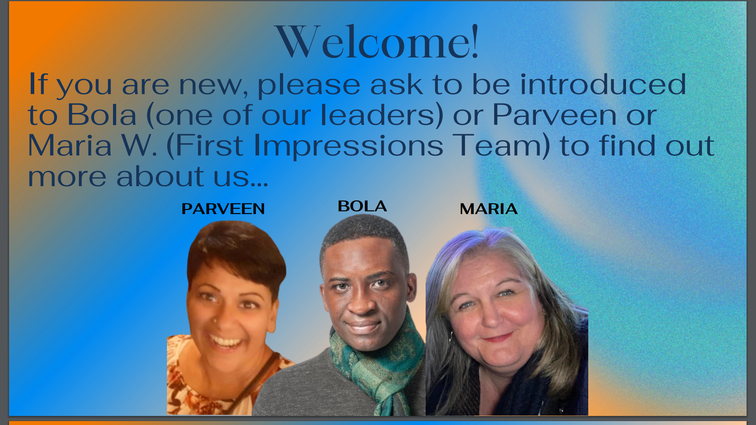

Slide 3
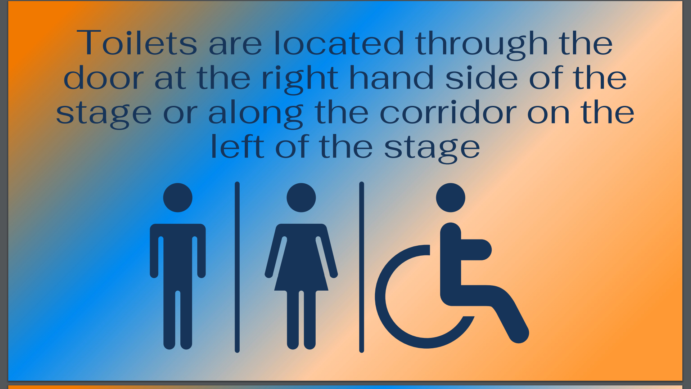

Slide 4
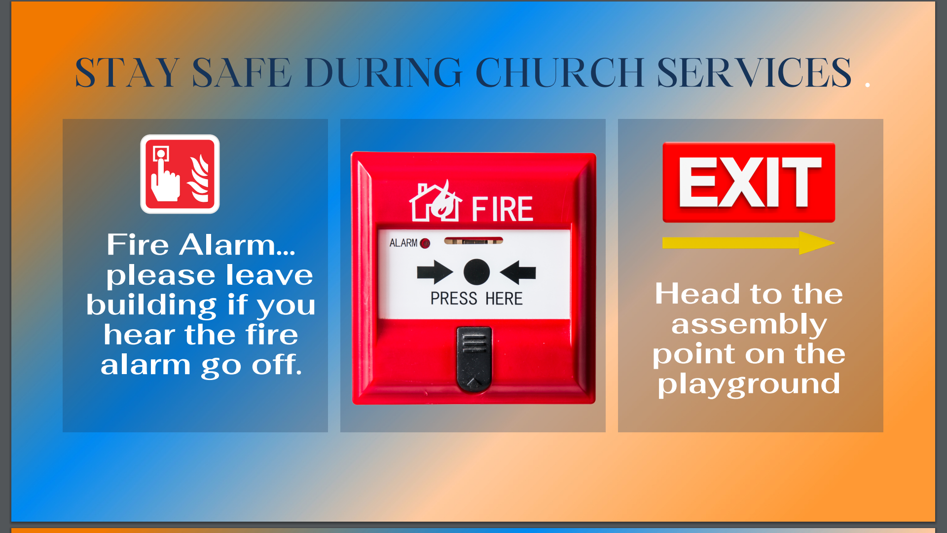

Slide 5


Slide 6
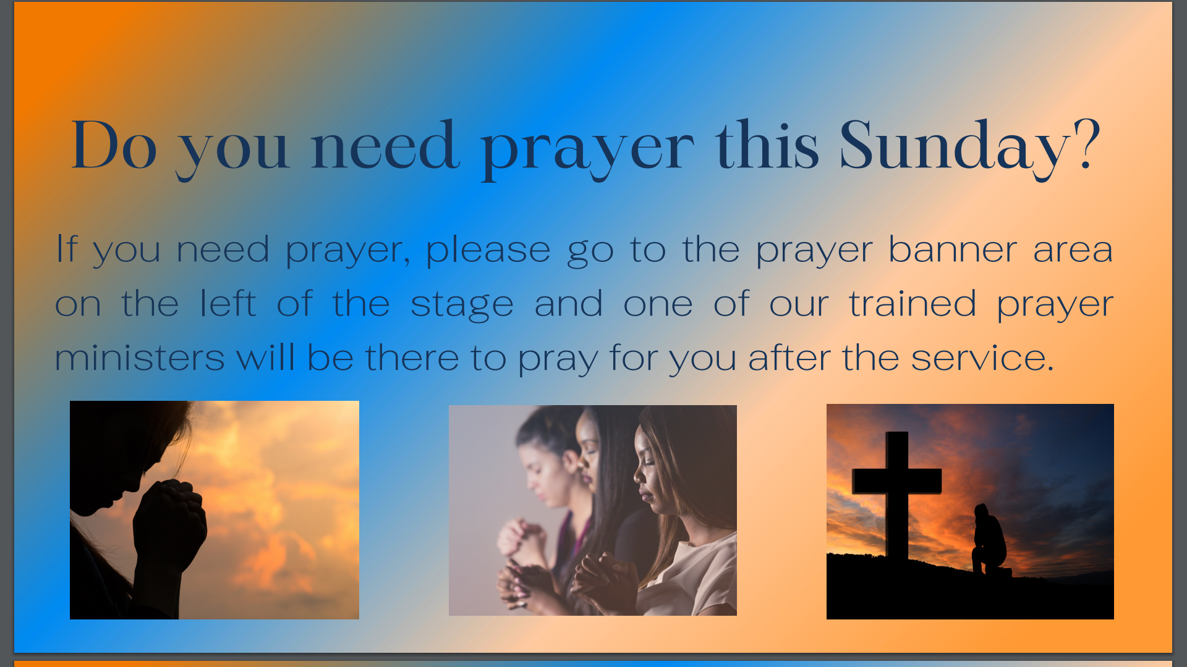

Slide 7


Slide 8
Cornerstone City Church Peninsula Plus Community Hoo Are Ya
3rd March 2024

Slide 9


Slide 10
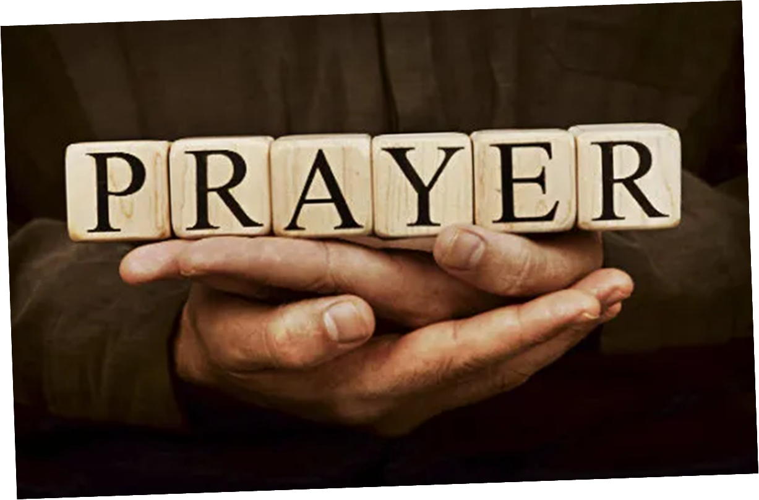

Slide 11


Slide 12
Praise
CCLI Song # 7213077
© Brandon Lake MusicFor Humans PublishingMaverick City PublishingCapitol CMG GenesisCapitol CMG ParagonHousefires SoundsWriter's Roof PublishingMusic by Elevation Worship Publishing
For use solely with the SongSelect® Terms of Use. All rights reserved. www.ccli.com
Note: Reproduction of this sheet music requires a CCLI Music Reproduction Licence. Please report all copies.
CCLI Licence No. 33265

Slide 13
1/12
Let everything that has breath
Praise the Lord
Praise the Lord

Slide 14
2/12
I’ll praise in the valley
Praise on the mountain
I’ll praise when I’m sure
Praise when I’m doubting

Slide 15
3/12
I’ll praise when outnumbered
Praise when surrounded
'Cause praise is the water
My enemies drown in

Slide 16
4/12
As long as I’m breathing
I’ve got a reason to Praise the Lord oh my soul
Praise the Lord oh my soul

Slide 17
5/12
I’ll praise when I feel it
And I’ll praise when I don’t
I’ll praise 'cause I know
You’re still in control

Slide 18
6/12
'Cause my praise is a weapon
It’s more than a sound
My praise is the shout
That brings Jericho down

Slide 19
7/12
As long as I’m breathing
I’ve got a reason to Praise the Lord oh my soul
Praise the Lord oh my soul

Slide 20
8/12
I won’t be quiet
My God is alive
How could I keep it inside
Praise the Lord oh my soul

Slide 21
9/12
I’ll praise 'cause You’re sovereign
Praise 'cause You reign
Praise 'cause You rose and defeated the grave
I’ll praise 'cause You’re faithful
Praise 'cause You’re true
Praise 'cause there’s nobody greater than You

Slide 22
10/12
Praise the Lord oh my soul
Praise the Lord oh my soul
Praise the Lord oh my soul
Praise the Lord oh my soul
I won’t be quiet
My God is alive
How could I keep it inside

Slide 23
1 1/12
I won’t be quiet
My God is alive
How could I keep it inside
I won’t be quiet
My God is alive
How could I keep it inside
Praise the Lord oh my soul

Slide 24
12/12
Let everything that has breath
Praise the Lord
Praise the Lord

Slide 25
Firm Foundation (He Won't)
CCLI Song # 7188203
Austin Davis | Chandler Moore | Cody Carnes
© 2021 For Humans Publishing (Admin by Essential Music Publishing)
Maverick City Publishing (Admin by Essential Music Publishing)
Capitol CMG Paragon (Admin. by Capitol CMG Publishing)
TBCO Publishing (Admin. by Capitol CMG Publishing)
Writer's Roof Publishing (Admin. by Capitol CMG Publishing)
A.L.K.D. Music (Admin. by Watershed Music Group (Admin. by Capitol CMG Publishing))
For use solely with the SongSelect® Terms of Use. All rights reserved. www.ccli.com
CCLI Licence No. 33265

Slide 26
1/6
Christ is my firm foundation
The rock on which I stand
When everything around me is shaken
I've never been more glad
That I put my faith in Jesus
'Cause He's never let me down
He's faithful through generations
So why would He fail now

Slide 27
2/6
He won’t
He won't

Slide 28
3/6
I've still got joy in chaos
I've got peace that makes no sense
So I won't be going under
I'm not held by my own strength
'Cause I've built my life on Jesus
He's never let me down
He's faithful in every season
So why would He fail now

Slide 29
4/6
He won’t He won't
He won't fail
He won't fail

Slide 30
5/6
Rain came and wind blew
My house was built on You
I'm safe with You
I'm going to make it through

Slide 31
6/6
I'm going to make it through
‘Cause I’m standing strong on You
I’m going to make it through
‘Cause my house is built on You

Slide 32
Great Are You Lord
CCLI Song # 6460220
David Leonard | Jason Ingram | Leslie Jordan
© 2012 Open Hands Music (Admin. by Essential Music Publishing LLC)
So Essential Tunes (Admin. by Essential Music Publishing LLC)
Integrity's Praise! Music (Admin. by Integrity Music Ltd)
Little Way Creative (Admin. by Integrity Music Ltd)
For use solely with the SongSelect® Terms of Use. All rights reserved. www.ccli.com
CCLI Licence No. 33265

Slide 33
1/3
You give life You are love
You bring light to the darkness
You give hope You restore ev'ry heart that is broken
And great are You Lord

Slide 34
2/3
It's Your breath in our lungs
So we pour out our praise
We pour out our praise
It's Your breath in our lungs
So we pour out our praise to You only

Slide 35
3/3
And all the earth will shout Your praise
Our hearts will cry these bones will sing
Great are You Lord
(REPEAT)

Slide 37
Holy Forever
CCLI Song # 7201044
Brian Johnson | Chris Tomlin | Jason Ingram | Jenn Johnson | Phil Wickham
© Phil Wickham Music (Admin. by / Small Stone Media BV, Holland (Admin. in the UK/Eire by Song Solutions www.songsolutions.org))
Simply Global Songs (Admin. by / Small Stone Media BV, Holland (Admin. in the UK/Eire by Song Solutions www.songsolutions.org))
Capitol CMG Paragon (Admin. by Capitol CMG Publishing)
S. D. G. Publishing (Admin. by Capitol CMG Publishing)
Be Essential Songs (Admin. by Essential Music Publishing LLC)
My Magnolia Music (Admin. by Essential Music Publishing LLC)
Bethel Music Publishing (Admin. by Song Solutions)
Brian and Jenn Publishing (Admin. by Song Solutions)
For use solely with the SongSelect® Terms of Use. All rights reserved. www.ccli.com
CCLI Licence No. 33265

Slide 38
1/10
A thousand generations falling down in worship
To sing the song of ages to the Lamb
And all who've gone before us
And all who will believe
Will sing the song of ages to the Lamb

Slide 39
2/10
(Jesus) Your name is the highest
Your name is the greatest
Your name stands above them all
All thrones and dominions
All powers and positions
Your name stands above them all

Slide 40
3/10
And the angels cry Holy
All creation cries Holy
You are lifted high Holy
Holy forever

Slide 41
4/10
If you've been forgiven and if you've been redeemed
Sing the song forever to the Lamb
If you walk in freedom and if you bear His name
Sing the song forever to the Lamb
We'll sing the song forever and amen

Slide 42
5/10
And the angels cry Holy
All creation cries Holy
You are lifted high Holy
Holy forever

Slide 43
6/10
Hear Your people sing Holy
To the King of Kings Holy
You will always be Holy
Holy forever

Slide 44
7/10
(Jesus) Your name is the highest
Your name is the greatest
Your name stands above them all
All thrones and dominions
All powers and positions
Your name stands above them all

Slide 45
8/10
And the angels cry Holy
All creation cries Holy
You are lifted high Holy
Holy forever

Slide 46
9/10
Hear Your people sing Holy
To the King of Kings Holy
You will always be Holy
Holy forever

Slide 47
10/10
You will always be Holy
Holy forever

Slide 49


Slide 50
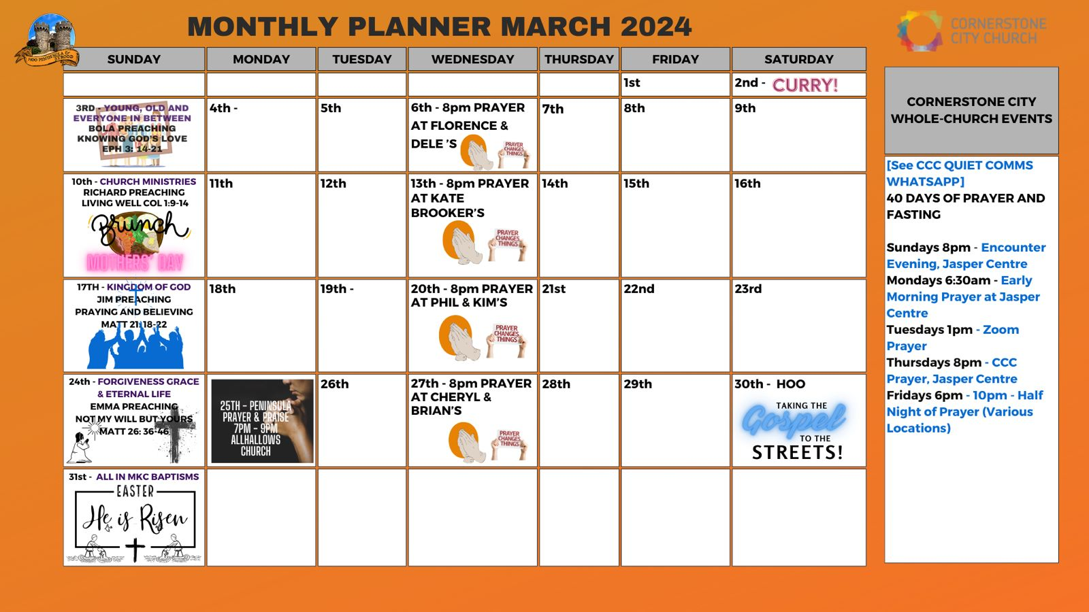

Slide 51
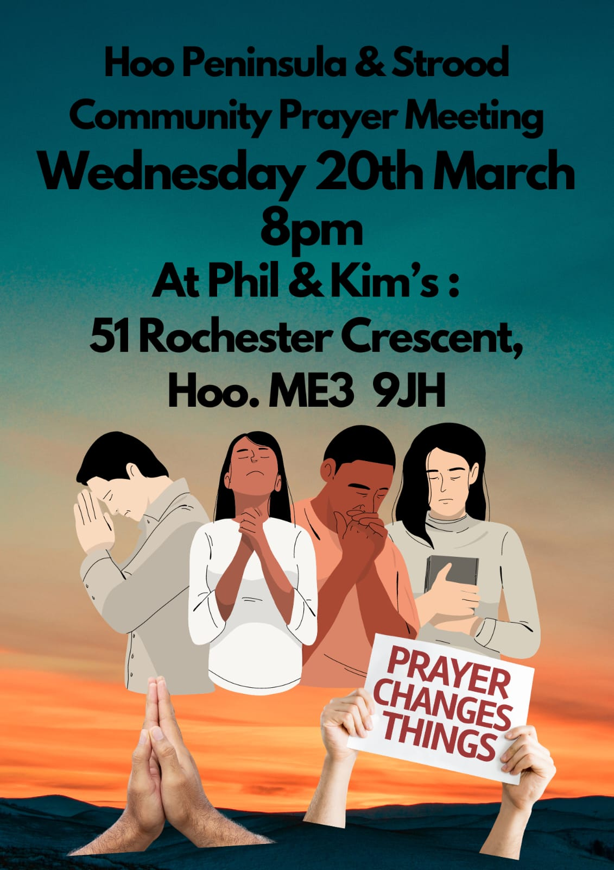

Slide 52


Slide 53


Slide 54


Slide 55


Slide 57


Slide 58


Slide 59
Too Good To Not Believe CCLI Song # 7174874
Brandon Lake | Chris Davenport | Cody Carnes | Josh Silverberg
© 2021 Capitol CMG Paragon; CDavs Music; Songs For TIM; Writer's Roof Publishing; Curb Congregation Songs; River Wild; Bethel Music Publishing; Brandon Lake Music; Maverick City Publishing Worldwide
For use solely with the SongSelect® Terms of Use. All rights reserved. www.ccli.com
CCLI Licence No. 33265

Slide 60
1/12
I’ve lived stories
That have proved Your faithfulness
I’ve seen miracles my mind can’t comprehend
There is beauty in what I can’t understand
Jesus it’s You Jesus it’s You

Slide 61
2/12
(I believe) You’re the wonder-working God
You’re the wonder-working God
All the miracles I’ve seen

Slide 62
3/12
Too good to not believe
You’re the wonder-working God
And You heal because You love
Oh the miracles we’ll see
You’re too good to not believe

Slide 63
4/12
You’re too good to not believe
You’re too good to not believe

Slide 64
5/12
I can’t resurrect a man with my own hands
But just the mention of Your name can raise the dead
So all the glory to the only One who can
Jesus it’s You Jesus it’s You

Slide 65
6/12
Too good to not believe
Too good to not believe
After everything I’ve seen
You’re too good to not believe Too good to not believe
Too good to not believe

Slide 66
7/12
I’ve seen cancer disappear
I’ve seen metal plates dissolve
Don’t you tell me He can’t do it
Don’t you tell me He can’t do it

Slide 67
8/12
I’ve seen real life resurrection
I’ve seen mental health restored
Don’t you tell me He can’t do it
Don’t you tell me He can’t do it

Slide 68
9/12
I’ve seen families reunited
I’ve seen prodigals return
Don’t you tell me He can’t do it
Don’t you tell me He can’t do it

Slide 69
10/12
I’ve seen troubled souls delivered
I’ve seen addicts finally free
Don’t you tell me He can’t do it
Don’t you tell me He can’t do it

Slide 70
11/12
We’ll see cities in revival
And salvation flood the streets
Don’t you tell me He can’t do it
Don’t you tell me He can’t do it

Slide 71
12/12
We’ll see glory fill the nations
Like the world has never seen
Don’t you tell me He can’t do it
'Cause I know that He can

Slide 73
2 Corinthians 14 May the grace of the Lord Jesus Christ, and the love of God, and the fellowship of the Holy Spirit be with you all

